Slide 1



MDM2019
Synchronization-Free GPS Spoofing Detection with
Crowdsourced Air Traffic Control
Gaoyang Liu, Rui Zhang, Chen Wang, Ling Liu

Slide 2
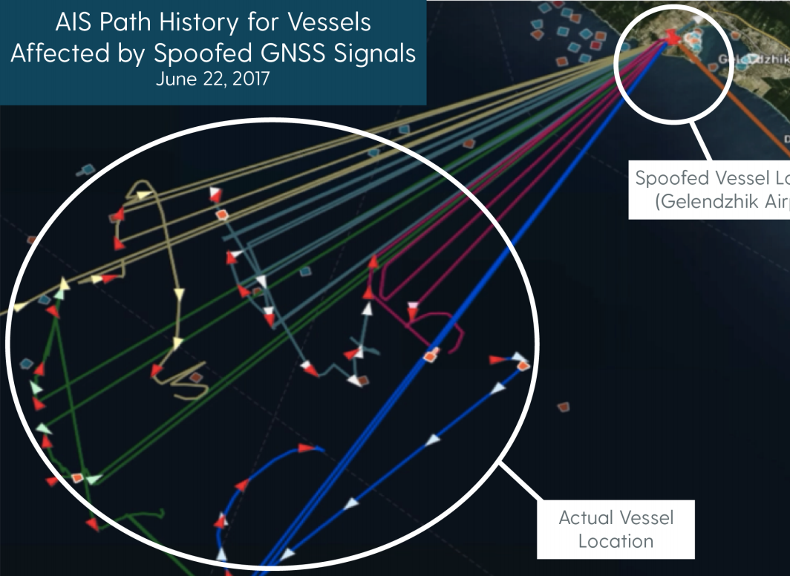
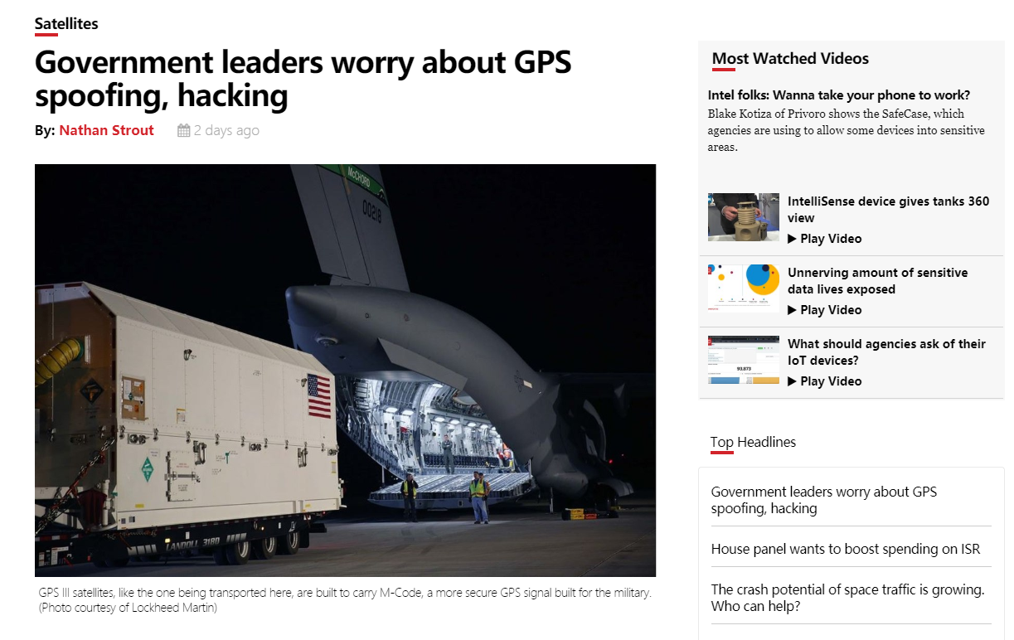
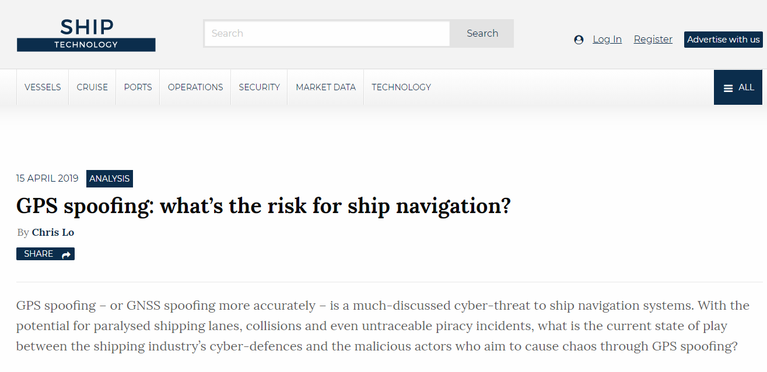
Background
Location History for Ships Affected by Spoofed GPS Signals
June 22, 2017
Spoofed GPS Ship Locations
Can We Detect GPS Spoofing?
GPS-Probe
Approximate Ship Locations

Slide 3

GPS/GNSS Spoofing Attacks
X
Spoofing
Attack
Detection
Spoofed
Real
GPS-Probe
GPS Spoofer

Slide 4
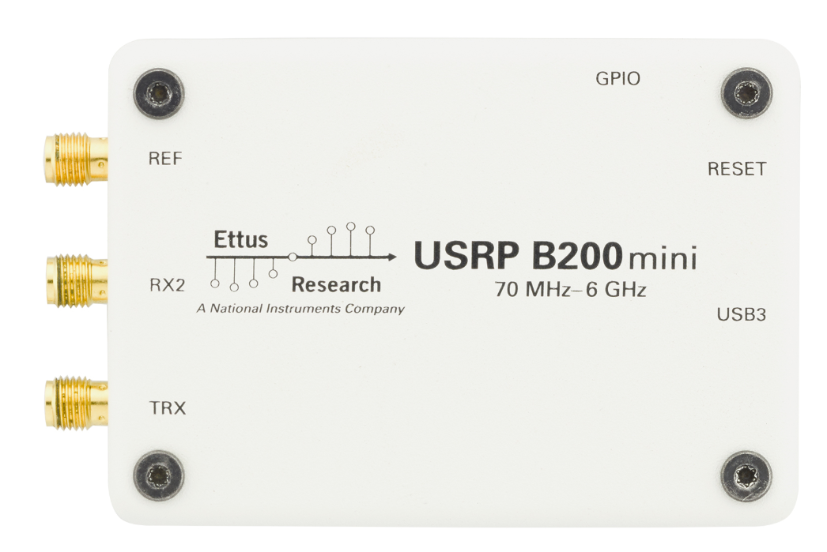
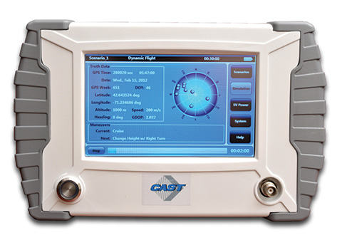
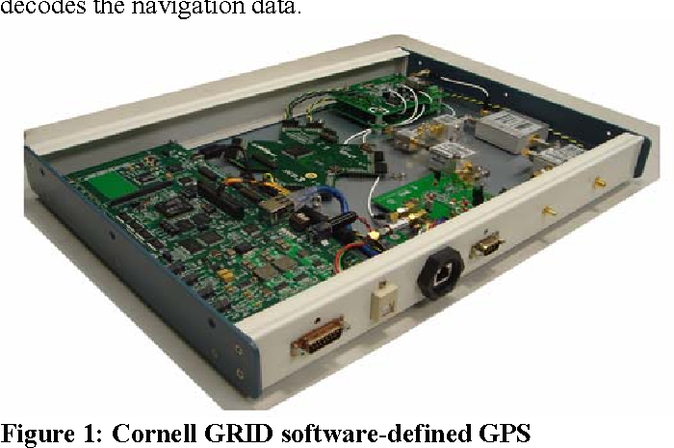
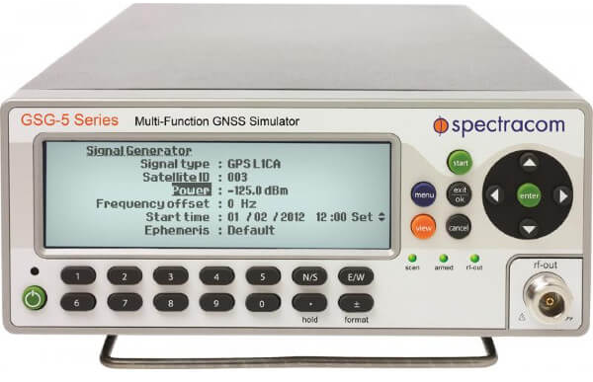
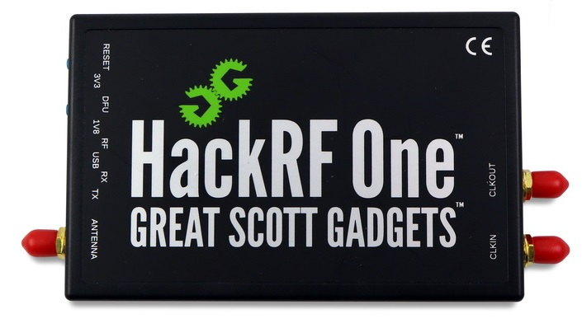
GPS/GNSS Spoofing Attacks
High Cost
Low Cost
High Complexity Device
GPS Special Simulator
Software Defined Radio
Past
Now

Slide 5
Existing Works
Wesson et al, (2018) | Method: Authenticating signals from satellites Drawback: Requiring a hardware upgrade of GPS system
Heng et al, (2015)
Wesson et al, (2012)
Montgomery et al,(2011) | Method: Focusing on the spoofing detection at signal processing level Drawback: Requiring customized GPS receivers,
Nielsen et al, (2011)
Psiaki et al,(2013)
Akos et al,(2012)

Slide 6


Existing Works
Crowd-GPS-Sec
Multilateration
Detection
GPS Position
$$≠$$
MLAT
Position
$$Spoofing?$$
Ground Sensors
K. Jansen, M. Sch¨afer, D. Moser, V. Lenders, C. P¨opper, and J. Schmitt,“Crowd-GPS-Sec: Leveraging crowdsourcing to detect and localize GPS spoofing attacks,” in Proceedings of IEEE S&P, 2018. I, IV, IV-D, V

Slide 7
Aircraft Broadcast Signals
ADS-B
Automatic Dependent Surveillance-Broadcast
Flarm
Portable Collision Avoidance System
Status Reports:
Aircraft ID,
Position,
Speed,
Heading

Slide 8
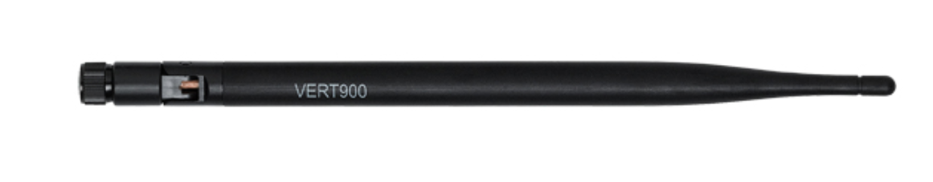
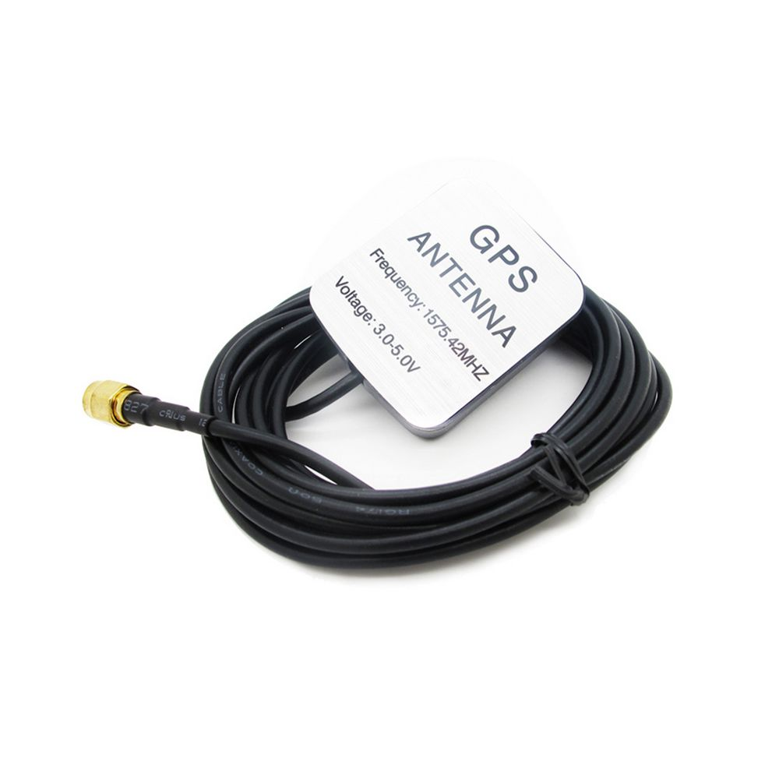
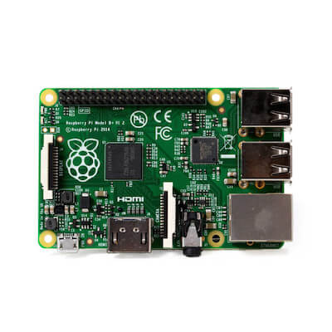
ADS-B/Flarm Report Surveillance
s
Aircraft
ADS-B/Flarm Sensors

Slide 9
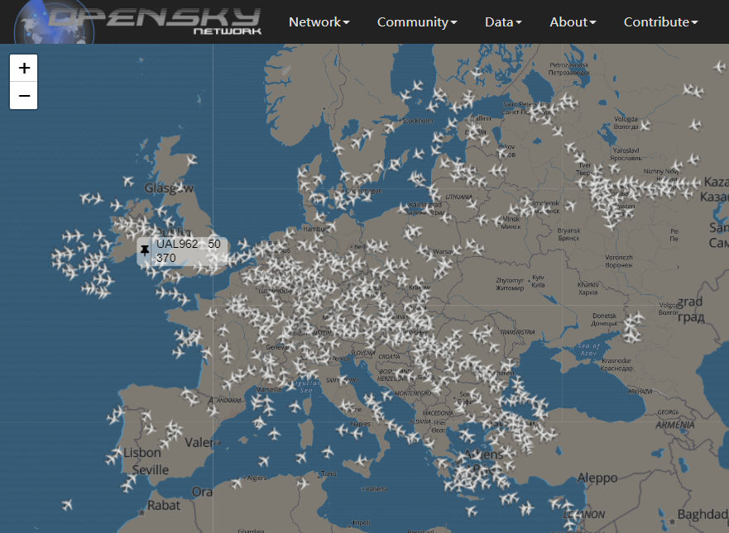
ADS-B/Flarm Report Surveillance
Opensky Network
Registered Receivers: 1777
Online Receivers: 775
Distict Countries: 190
https://opensky-network.org/

Slide 10
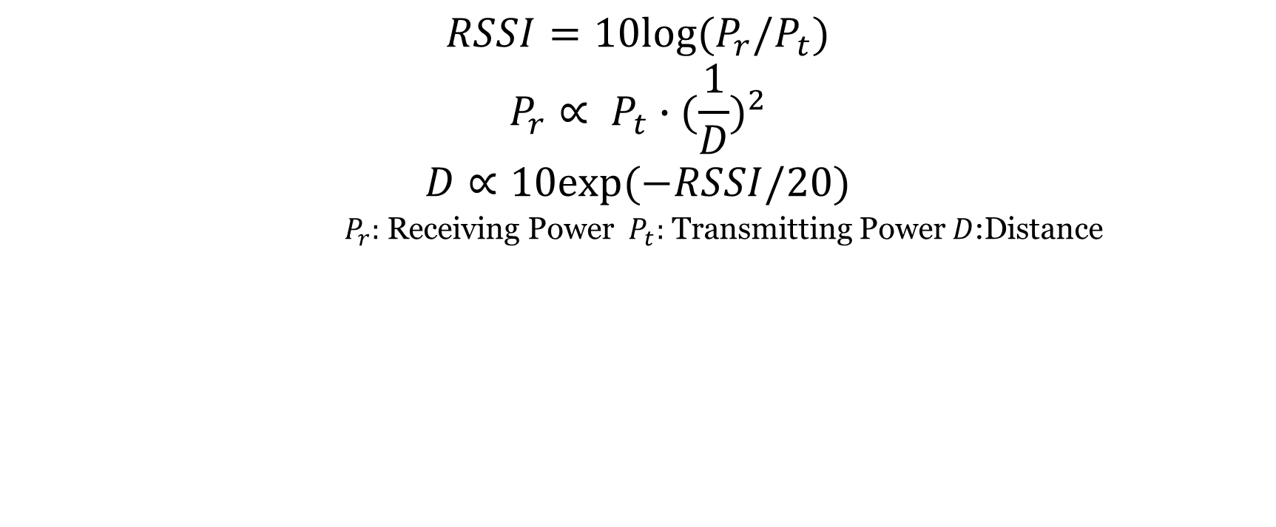
Received Signal Strength Indicator(RSSI)
$$RSSI=10log⁡(P_{r}/P_{t})$$
$$P_{r}∝ P_{t}∙{(\frac{1}{D})}^{2}$$
$$D∝10exp⁡(−RSSI/20)$$
$P_{r}:$ Receiving Power $P_{t}:$ Transmitting Power $D$:Distance
Synchronization-Free
GPS-Probe
GPS Transmitter
GPS Receiver

Slide 11
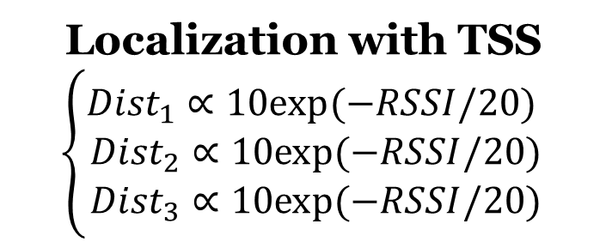
Aircraft Localization with RSSI
Localization with TSS
$$\left\{\begin{aligned}{Dist}_{1}∝10exp⁡(−RSSI/20) \\ {Dist}_{2}∝10exp⁡(−RSSI/20) \\ {Dist}_{3}∝10exp⁡(−RSSI/20)\end{aligned}\right.$$
RSSI3
Dist2
3 RSSI values can locate an aircraft.
Dist1
RSSI3
GPS-Probe
RSSI1
RSSI2

Slide 12
Time Stamp at Server(TSS)
Synchronization-Free
GPS-Probe
Time Stamp
at Server
GPS Broadcast
Center Server

Slide 13
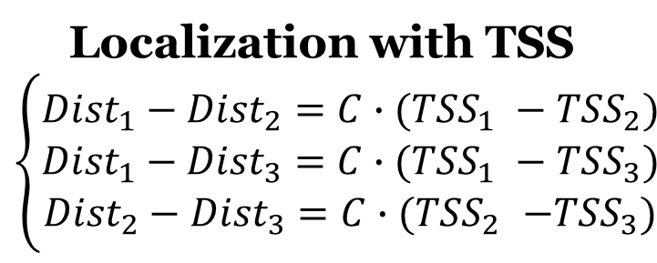
Aircraft Localization with TSS
Localization with TSS
$$\left\{\begin{aligned}{Dist}_{1}−{Dist}_{2}={C∙(TSS}_{1} −{TSS}_{2}) \\ {Dist}_{1}−{Dist}_{3}={C∙(TSS}_{1} −{TSS}_{3}) \\ {Dist}_{2}−{Dist}_{3}{=C∙(TSS}_{2} −{TSS}_{3})\end{aligned}\right.$$
Dist3
Dist2
3 TSS values can locate an aircraft.
Dist1
TSS3
GPS-Probe
TSS2
TSS1

Slide 14

GPS Spoofing Detection
GPS-Probe Localization
GPS-Probe Detection
GPS Position
GPS-Probe Position
Machine Learning
GPS Position
GPS-Probe Position
$$Spoofing?$$

Slide 15
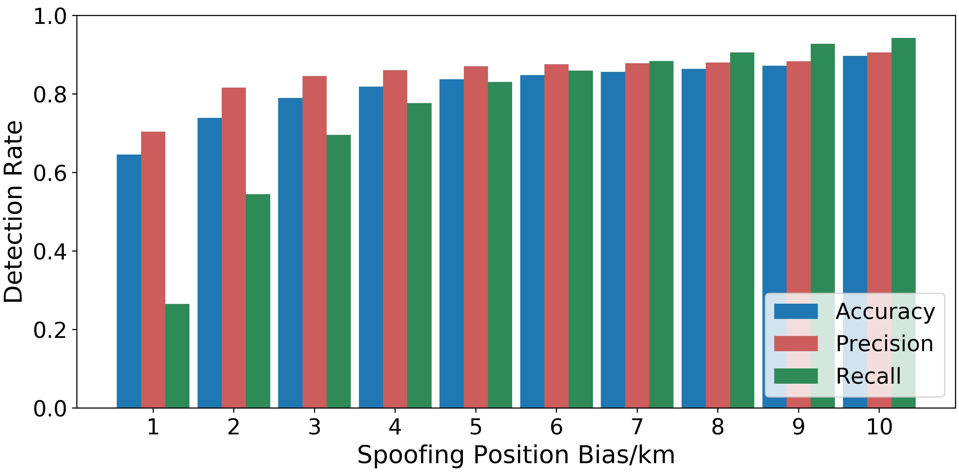
Performance Evaluation
Spoofing Position Bias:
Range from 1km to 10km, significant impact, accuracy increasing from 65% to 90%

Slide 16
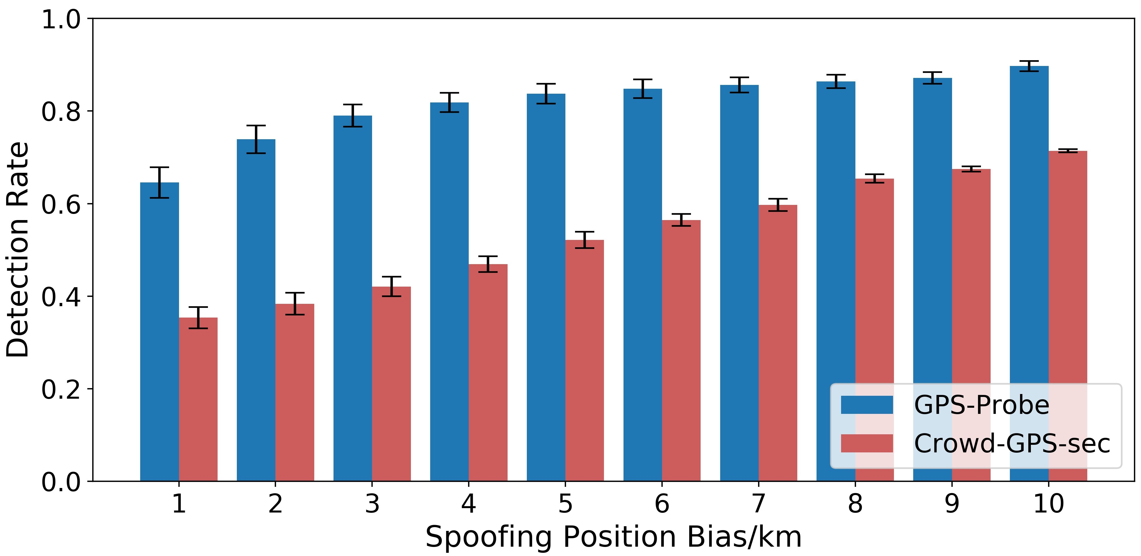
Performance Evaluation
Comparison with Crowd-GPS-sec:
GPS-Probe achieves the mean detection rate of 81.7%, better than Crowd-GPS-Sec by 28.2%

Slide 17
Summary
GPS-Probe
First work using Machine Learning and Crowdsourcing technologies to detect GPS spoofing attacks
Neither requiring changes of the GPS protocols nor the upgrades of the hardwares
Not requiring synchronization of ground GPS sensors
Future Work
Detecting the malicious ground sensors
Applying GPS-Probe to other networks

Slide 18
Thanks for your attention
Q&A

Slide 19
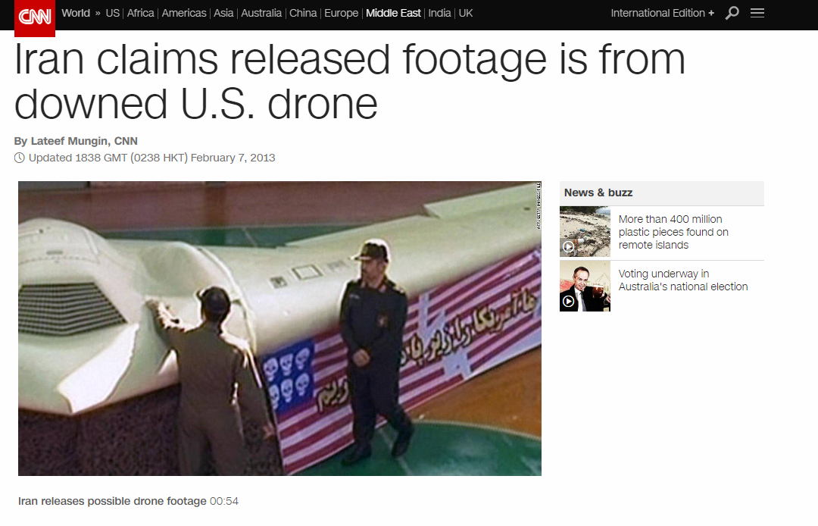

Background

Slide 20

GPS Spoofing Detection（NEED mode）
GPS-Probe Localization
GPS-Probe Detection
GPS Position
Machine Learning
$$Spoofed$$
Or Not?
GPS-Probe Position

Slide 21
Received Signal Strength Indicator(RSSI)
$$RSSI=10log⁡(P_{r}/P_{t})$$
$$P_{r}∝ P_{t}∙{(\frac{1}{D})}^{2}$$
$$D∝10exp⁡(−RSSI/20)$$
$P_{r}:$ Receiving Power $P_{t}:$ Transmitting Power $D$:Distance
RSSI doesn’t need to be synchronized!
GPS Transmitter
GPS-Probe
GPS Receiver

Slide 22
Aircraft Localization with RSSI
3 RSSI values can locate an aircraft.
RSSI3
RSSI2
RSSI1
GPS-Probe
Sensor3
Sensor1
Sensor2

Slide 23
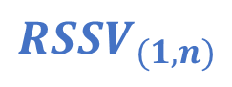
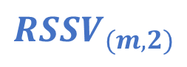
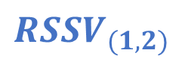
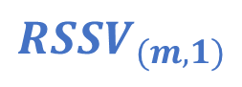

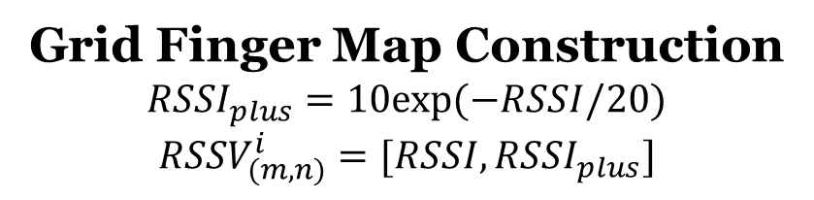
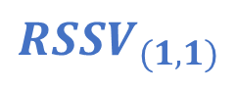
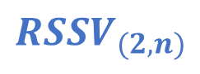
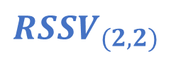
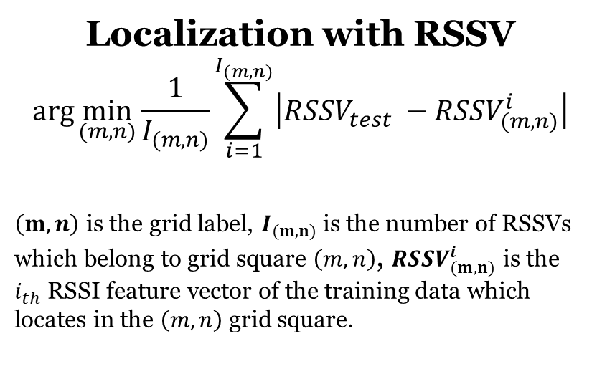
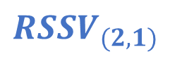
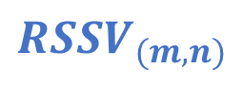
Aircraft Localization with RSSI
Grid Finger Map Construction
$${RSSI}_{plus}=10exp⁡(−RSSI/20)$$
$${RSSV}_{(m,n)}^{i}=[RSSI,{RSSI}_{plus}]$$
$${RSSV}_{(1,1)}$$
$${RSSV}_{(1,2)}$$
$${RSSV}_{(1,n)}$$
Localization with RSSV
$$\arg{\min_{(m,n)}{\frac{1}{I_{(m,n)}}\sum_{i=1}^{I_{(m,n)}}{\left|{RSSV}_{test} −{RSSV}_{(m,n)}^{i}\right|}}}$$
$\left(m,n\right)$ is the grid label, $I_{(m,n)}$ is the number of RSSVs which belong to grid square $\left(m,n\right)$, ${RSSV}_{(m,n)}^{i}$ is the $i_{th}$ RSSI feature vector of the training data which locates in the $\left(m,n\right)$ grid square.
$${RSSV}_{(2,1)}$$
$${RSSV}_{(2,2)}$$
$${RSSV}_{(2,n)}$$
$${RSSV}_{test}$$
$${RSSV}_{(m,1)}$$
$${RSSV}_{(m,2)}$$
$${RSSV}_{(m,n)}$$

Slide 24
Aircraft Localization with RSSI

Slide 25
Aircraft Localization with RSSI
Select 2 Neighbors
Select 4 Neighbors

Slide 26
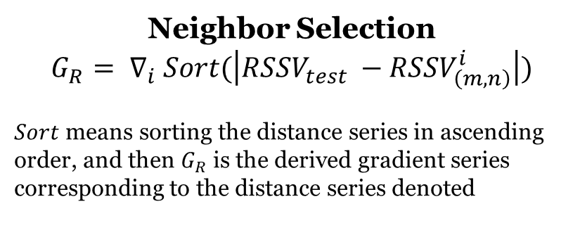
Aircraft Localization with RSSI
Select 3 Neighbors
Neighbor Selection
$$G_{R}= ∇_{i} Sort(\left|{RSSV}_{test} −{RSSV}_{\left(m,n\right)}^{i}\right|)$$
$Sort$ means sorting the distance series in ascending order, and then $G_{R}$ is the derived gradient series corresponding to the distance series denoted

Slide 27
Time Stamp at Server(TSS)
TSS doesn’t need to be synchronized!
GPS-Probe
Propagation Time
Time Stamp
at Server
Internet Delay
Time Stamp
at Sensor
Center Server

Slide 28
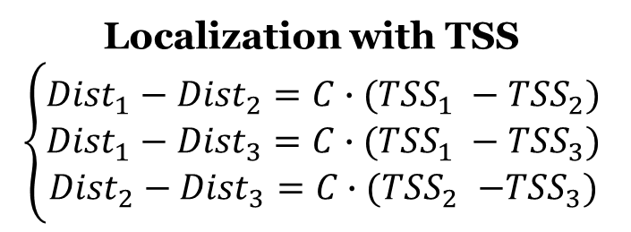
Aircraft Localization with TSS
Localization with TSS
$$\left\{\begin{aligned}{Dist}_{1}−{Dist}_{2}={C∙(TSS}_{1} −{TSS}_{2}) \\ {Dist}_{1}−{Dist}_{3}={C∙(TSS}_{1} −{TSS}_{3}) \\ {Dist}_{2}−{Dist}_{3}{=C∙(TSS}_{2} −{TSS}_{3})\end{aligned}\right.$$
Dist3
3 TSS values can locate an aircraft.
Dist2
Dist1
TSS3
GPS-Probe
TSS2
TSS1

Slide 29
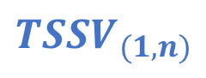
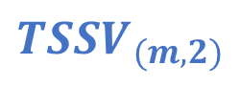
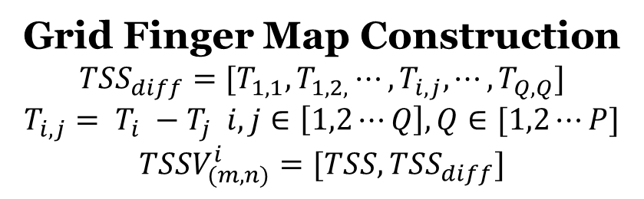
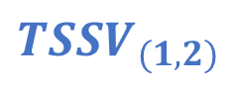
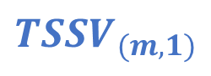

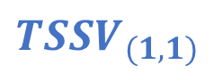
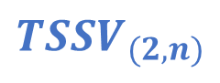
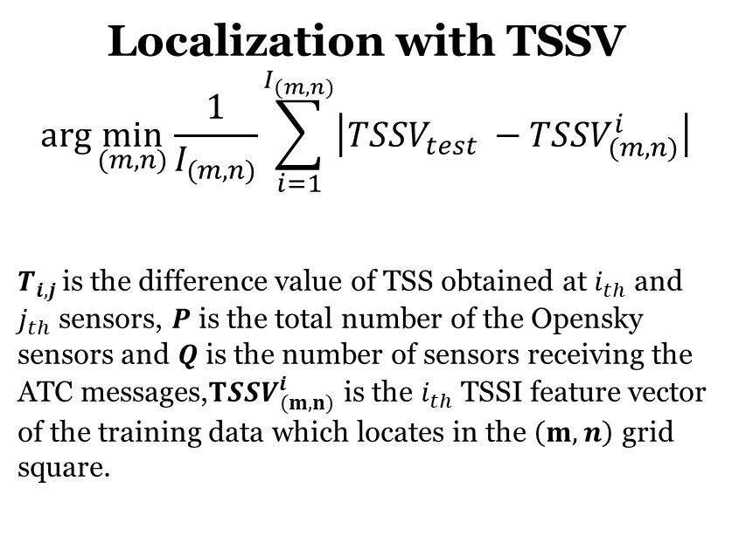
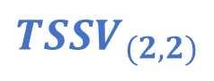
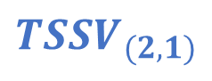
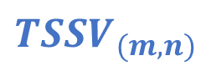
Aircraft Localization with RSSI
Grid Finger Map Construction
$${TSS}_{diff}={[T}_{1,1},T_{1,2,}⋯,T_{i,j},⋯,T_{Q,Q}]$$
$$T_{i,j}= T_{i} −T_{j} i,j∈\left[1,2⋯Q\right],Q∈[1,2⋯P]$$
$${TSSV}_{(m,n)}^{i}=[TSS,{TSS}_{diff}]$$
$${TSSV}_{(1,1)}$$
$${TSSV}_{(1,2)}$$
$${TSSV}_{(1,n)}$$
Localization with TSSV
$$\arg{\min_{(m,n)}{\frac{1}{I_{(m,n)}}\sum_{i=1}^{I_{(m,n)}}{\left|{TSSV}_{test} −{TSSV}_{(m,n)}^{i}\right|}}}$$
$T_{i,j }$is the difference value of TSS obtained at $i_{th}$ and $j_{th}$ sensors, $P$ is the total number of the Opensky sensors and $Q$ is the number of sensors receiving the ATC messages,${TSSV}_{(m,n)}^{i}$ is the $i_{th}$ TSSI feature vector of the training data which locates in the $\left(m,n\right)$ grid square.
$${TSSV}_{(2,1)}$$
$${TSSV}_{(2,2)}$$
$${TSSV}_{(2,n)}$$
$${RSSV}_{test}$$
$${TSSV}_{(m,1)}$$
$${TSSV}_{(m,2)}$$
$${TSSV}_{(m,n)}$$

Slide 30
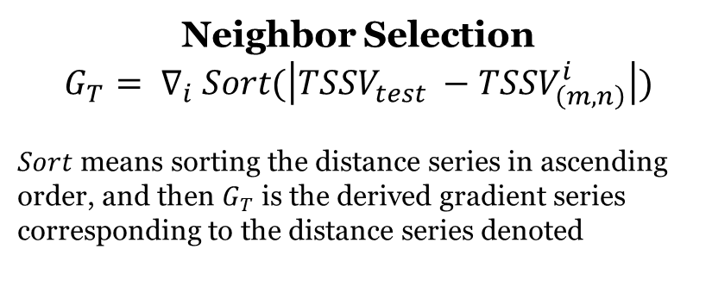
Aircraft Localization with TSS
Select 3 Neighbors
Neighbor Selection
$$G_{T}= ∇_{i} Sort(\left|{TSSV}_{test} −{TSSV}_{\left(m,n\right)}^{i}\right|)$$
$Sort$ means sorting the distance series in ascending order, and then $G_{T}$ is the derived gradient series corresponding to the distance series denoted

